Slide 1
DTECTS Board Design
Ergsense, Contract Work 2017
Justin Reina
Notes:
Presentation Contents
1 Challenges & Needs (1)
2 Design Procedure (2)
3 Development Methodology (3)
4 Overcome Challenges (1)
5 Deliverable & Results (2)
6 Learnings & Growths (1)
7 Outcomes (1)
8 Procedure (M) (1)
9 Pivotal Value Statement (M) (1)
Total (13)
Dev Focus
Start big, with goal for description of full picture
On completion, then revise down to meet ‘Rules’
Rules
3 min / slide
45 min presentation -> 15 slides max

Slide 2
“How you started the discussion, how do we move past Arduino?”
“As long as I’m involved we’re in idea generation. This happens”
Roadmap established without path to market
Focus & clarity needed
“As long as I’m involved, we’re in idea generation. This happens”
“How do we move past Arduino?”
Notes:
“When inventor meets IOT”
//…
Presentation Contents
1 Challenges & Needs (1)
2 Design Procedure (2)
3 Development Methodology (3)
4 Overcome Challenges (1)
5 Deliverable & Results (2)
6 Learnings & Growths (1)
7 Outcomes (1)
8 Procedure (M) (1)
9 Pivotal Value Statement (M) (1)
Total (13)
Dev Focus
Start big, with goal for description of full picture
On completion, then revise down to meet ‘Rules’
Rules
3 min / slide
45 min presentation -> 15 slides max
And welcome, to the era of IOT

Slide 3
Digital Tracking of Electrical Current & Transducers Solution (DTECTS)
The edge analytics solution, for continuous commissioning and monitoring of fault detection for electric motor & power transformer assets

Slide 4
Customer Request
Novel embedded device work with esteemed peer
DTECTS for Ergsense
Embedded Design Work
Board Revisions
Feature Integration
Firmware Architecture
Stabilization
Design Simplification
Path to Market
Notes:
Summary
Identification of Needs & Challenges
Topics
Stabilized Firmware Architecture
OTM evaluate, path option identifications (Arduino, Python, OTM(C/C++), PlatformIO, Lua, JavaScript)
Board Revisions
PoC Progression, Arduino towards release
Feature Integration
Features Proposed
Debug Port (JTAG)
Serial Port & Module
Jumpers
Presentation Focus Points
Opportunity
Success & Deliverable
Network & Relationships
Learnings and Growth
Points to Share
Success of work
Highlight Hardware Experience
Show direct value to team, by example
Shared
Contract Identified
Work Selection

Slide 5
Feather Opportunities
Cross-compatible platform spanning several vendors, use cases & solutions
Picture of Hats or Feather options
What feature or family do you need, they’ve got it w/example
A leading expression platform at present
Enables idea generation and investigation by large audience
Like the DTECTS platform with Ergsense, enabling real-time monitoring of electrical motors
With academic physics experimentation, chemistry monitoring or computer science embedded user interfaces for example
In industry with PoC examination & formulation (e.g. grain moisture detection)
This platform genre is maturing
Integration into later stages of product design & release
Arduino, Feather, Particle, etc.
"At its core, the Adafruit Feather is a complete ecosystem of products - and the best way to get your project flying” [1]
Notes:
What it is
Who uses it
Where it is going
Tomm Product Description
Why Tomm picked feather & motion established
What it brought to Tomm’s project (DTECTS)
Tomm Product Description
A simple motor interface to monitor performance, detect status & alert on performance error
Includes wireless interfaces, multiple sensing options, battery & web interfaces
Feather Selection
Selected for ability to express ideas, test viability and begin PoC development by upper mgmt
Allowed Tomm to generate working unit with market prospect quickly
Enabled generation by one person
Feather Benefits for DTECTS
Wide range of reference
Clean IO interface for DTECTS socket integration
Simple operating conditions (power, stable IO)
Highly Debuggable

Slide 6
Work Performed
Path identification
Bare-metal investigate
Standardized design practices?
Design Standardization
Revisioning (multiple repositories)
Schematics (modularization, consistency)
Board (features, design flexibility)
Secure a Path Forward
Standardization & Organization
Clarity of Communications & Media
Notes:
Project ramp (remote site visits, project acclimate, Arduino explore)
Path identification
Bare metal investigation, ESP32
…
Revisioning formalization & team sharing (GitHub)
Project & documentation standardization
Schematics & project standardize
Board architecture standardize
Path forward to product generation

Slide 7
Design Procedure (2)
Notes:
Needs Identification
Time Spent:
In-person visits, hands on time with DUT to establish scope & path forward
Time on the seat trying things that were known to not succeed, in order to communicate this (ESP, Hand Re-work, PCB Design Selections, Comm Interfaces)
Clear Scope with Doc of Ideas
Present ideas with articulation, PoC when possible
Firmware Development
Time Spent: Espressif VM, ESP-SDK Ramp & Feather Deployment (JTAG)
Focused on path to market and only stepped in on request (Arduino) or for path (ESP)
Focused on tangible results, shared with customer and asked for decision on next steps
Board Development
Time Spent: EAGLE Ramp, Existing Design Port, Revision Proposal, Revision Generation & Release
Contract Completion & Transfer
HW: Project & Board Revision
FW: OTM spec w/path to use (complete VM w/next steps & design support)
Design: Clear organization & repo integration, Identification of OTM, Python & JavaScript options

Slide 8
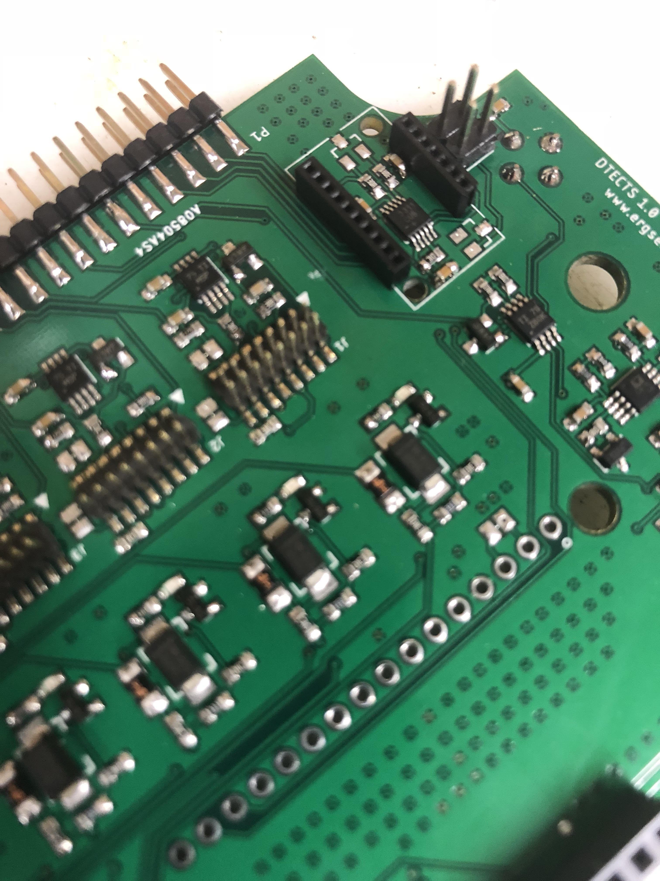
Features Added
Design
Jumpers
Serial Port
JTAG Port
Project
Organized Schematics
Unified Library
Board Modularization
Design
Jumpers
Serial Port
JTAG Port
Project
Organized Schematics
Unified Library
Board Modularization
Design
Jumpers
Serial Port
JTAG Port
Project
Organized Schematics
Unified Library
Board Modularization
DTECTS 1.0 (2017)

Slide 9
Development Methodology (3)
Notes:
Documentation
Presentation
Embedded Systems Development
Board Design
Code Syntax (share examples from code)
example_pwm_tc.c reference
Development Validation
PoC Form
Schematic Examples
Content Transfer to Ergsense
Revision Control

Slide 10
Development Methodology (3)
Revision Control
Clear segmentation of work with external team repository
Notes:
Documentation
Presentation
Embedded Systems Development
Board Design
Code Syntax (share examples from code)
example_pwm_tc.c reference
Development Validation
PoC Form
Schematic Examples
Content Transfer to Ergsense
Revision Control

Slide 11
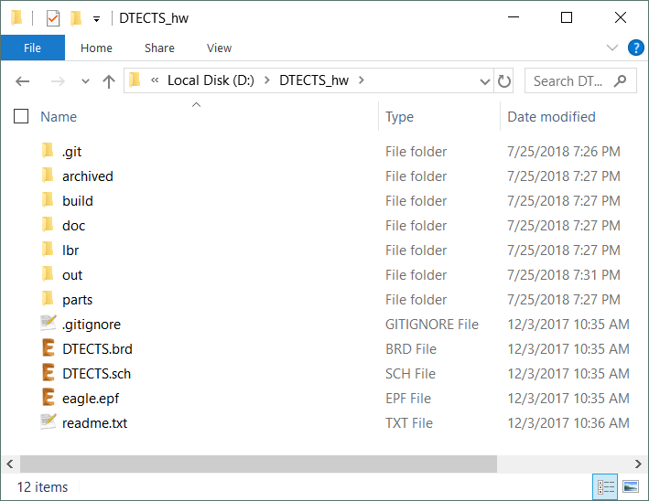
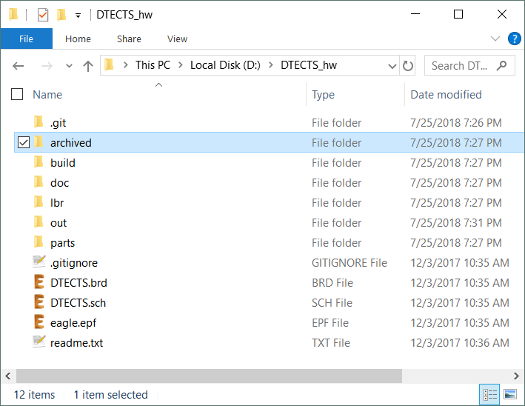
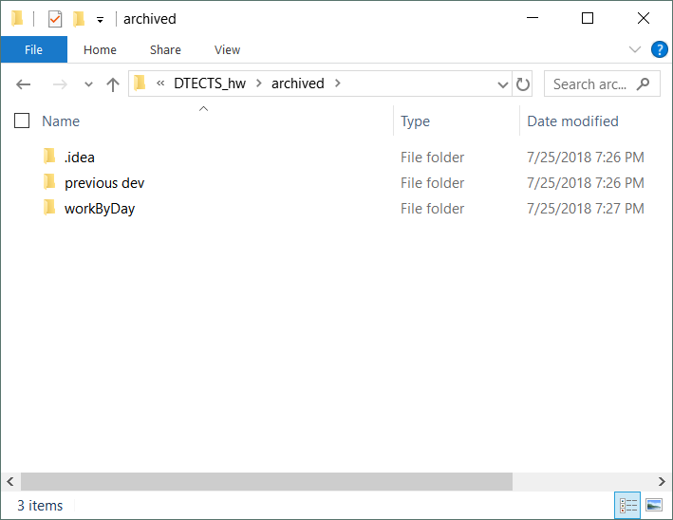
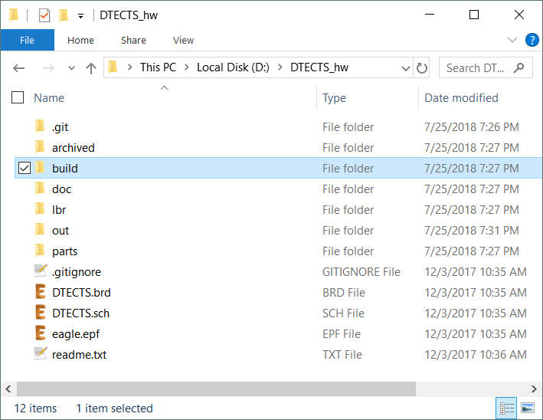
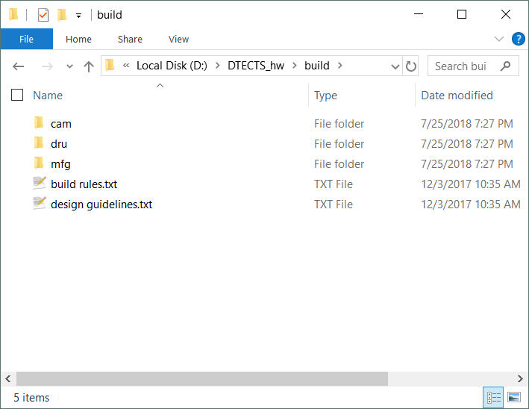
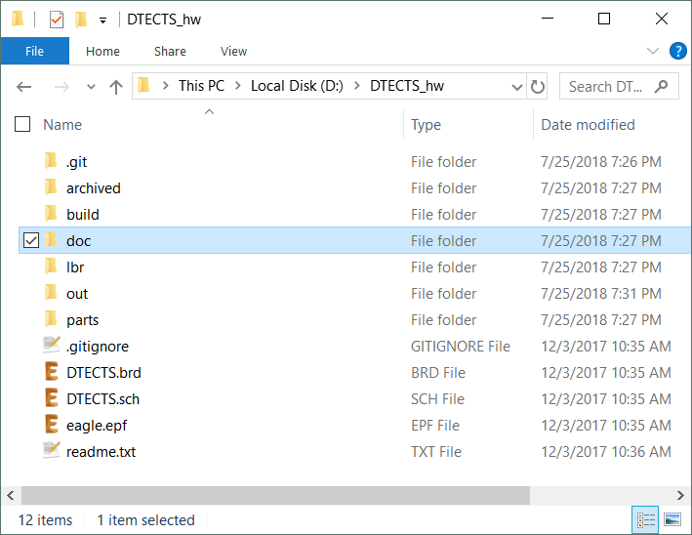
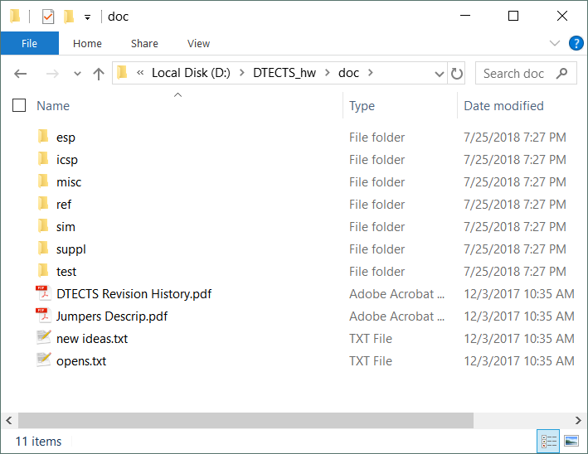
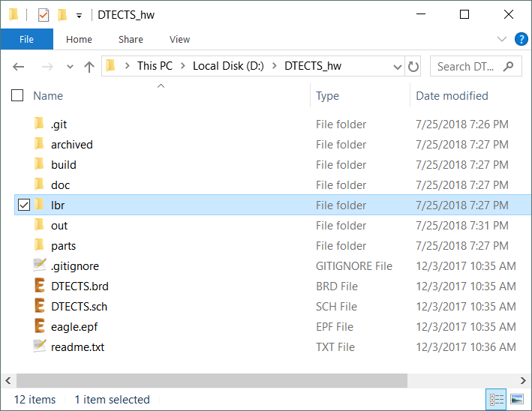
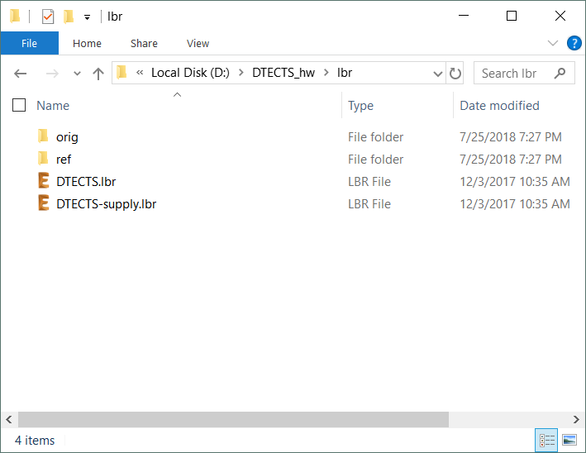
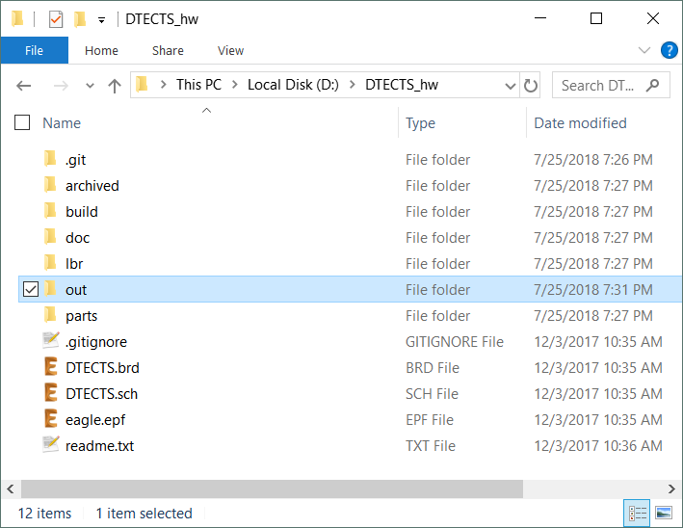
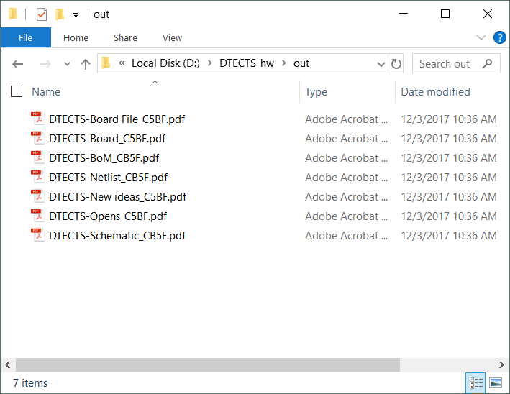
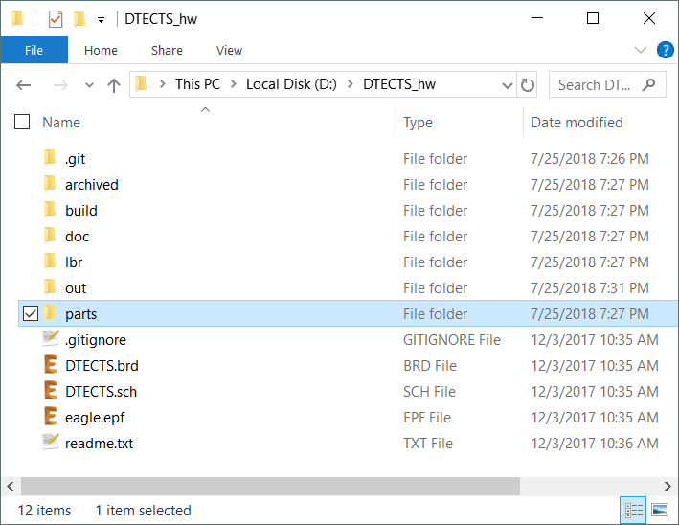
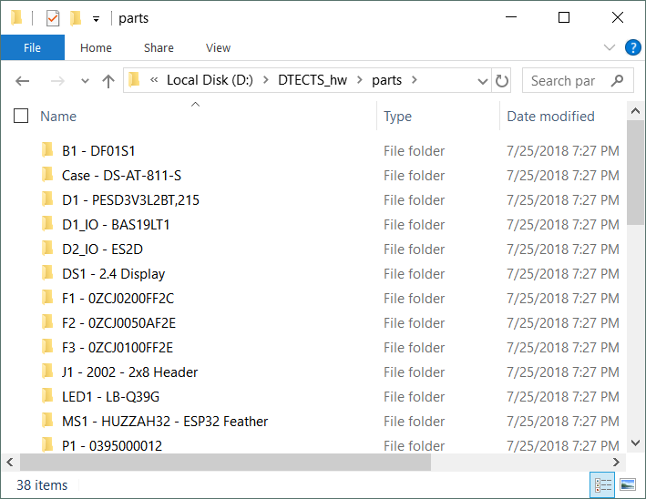
DTECTS Project Layout
Notes:
Clear segmentation and modularization of design
Uniform, consistent layout
Clear labelling with notes

Slide 12
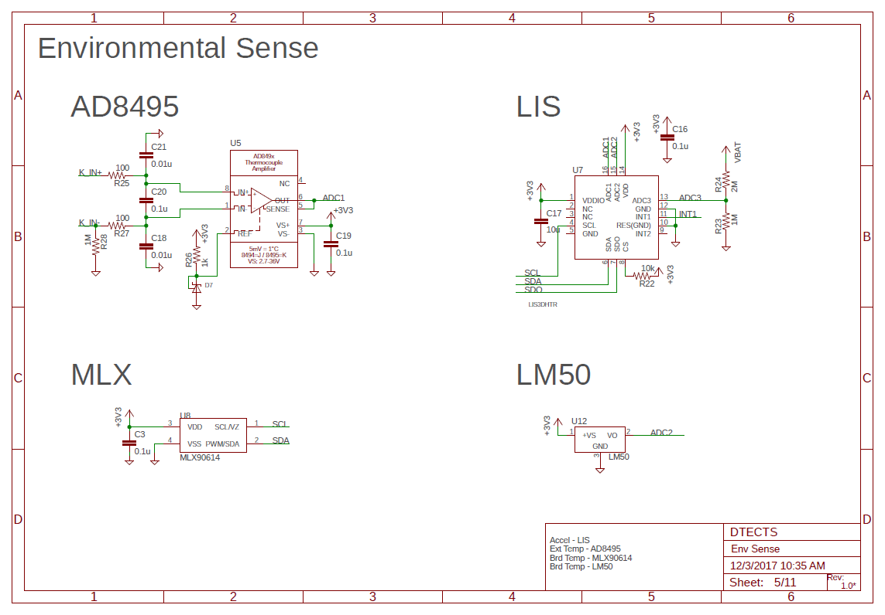
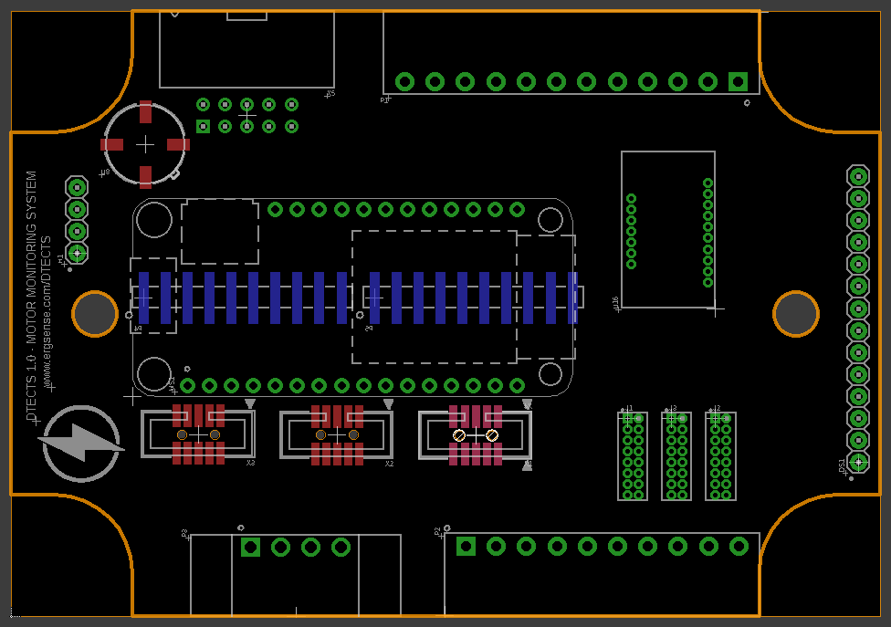
DTECTS Schematic
Notes:
Clear segmentation and modularization of design
Uniform, consistent layout
Clear labelling with notes

Slide 13
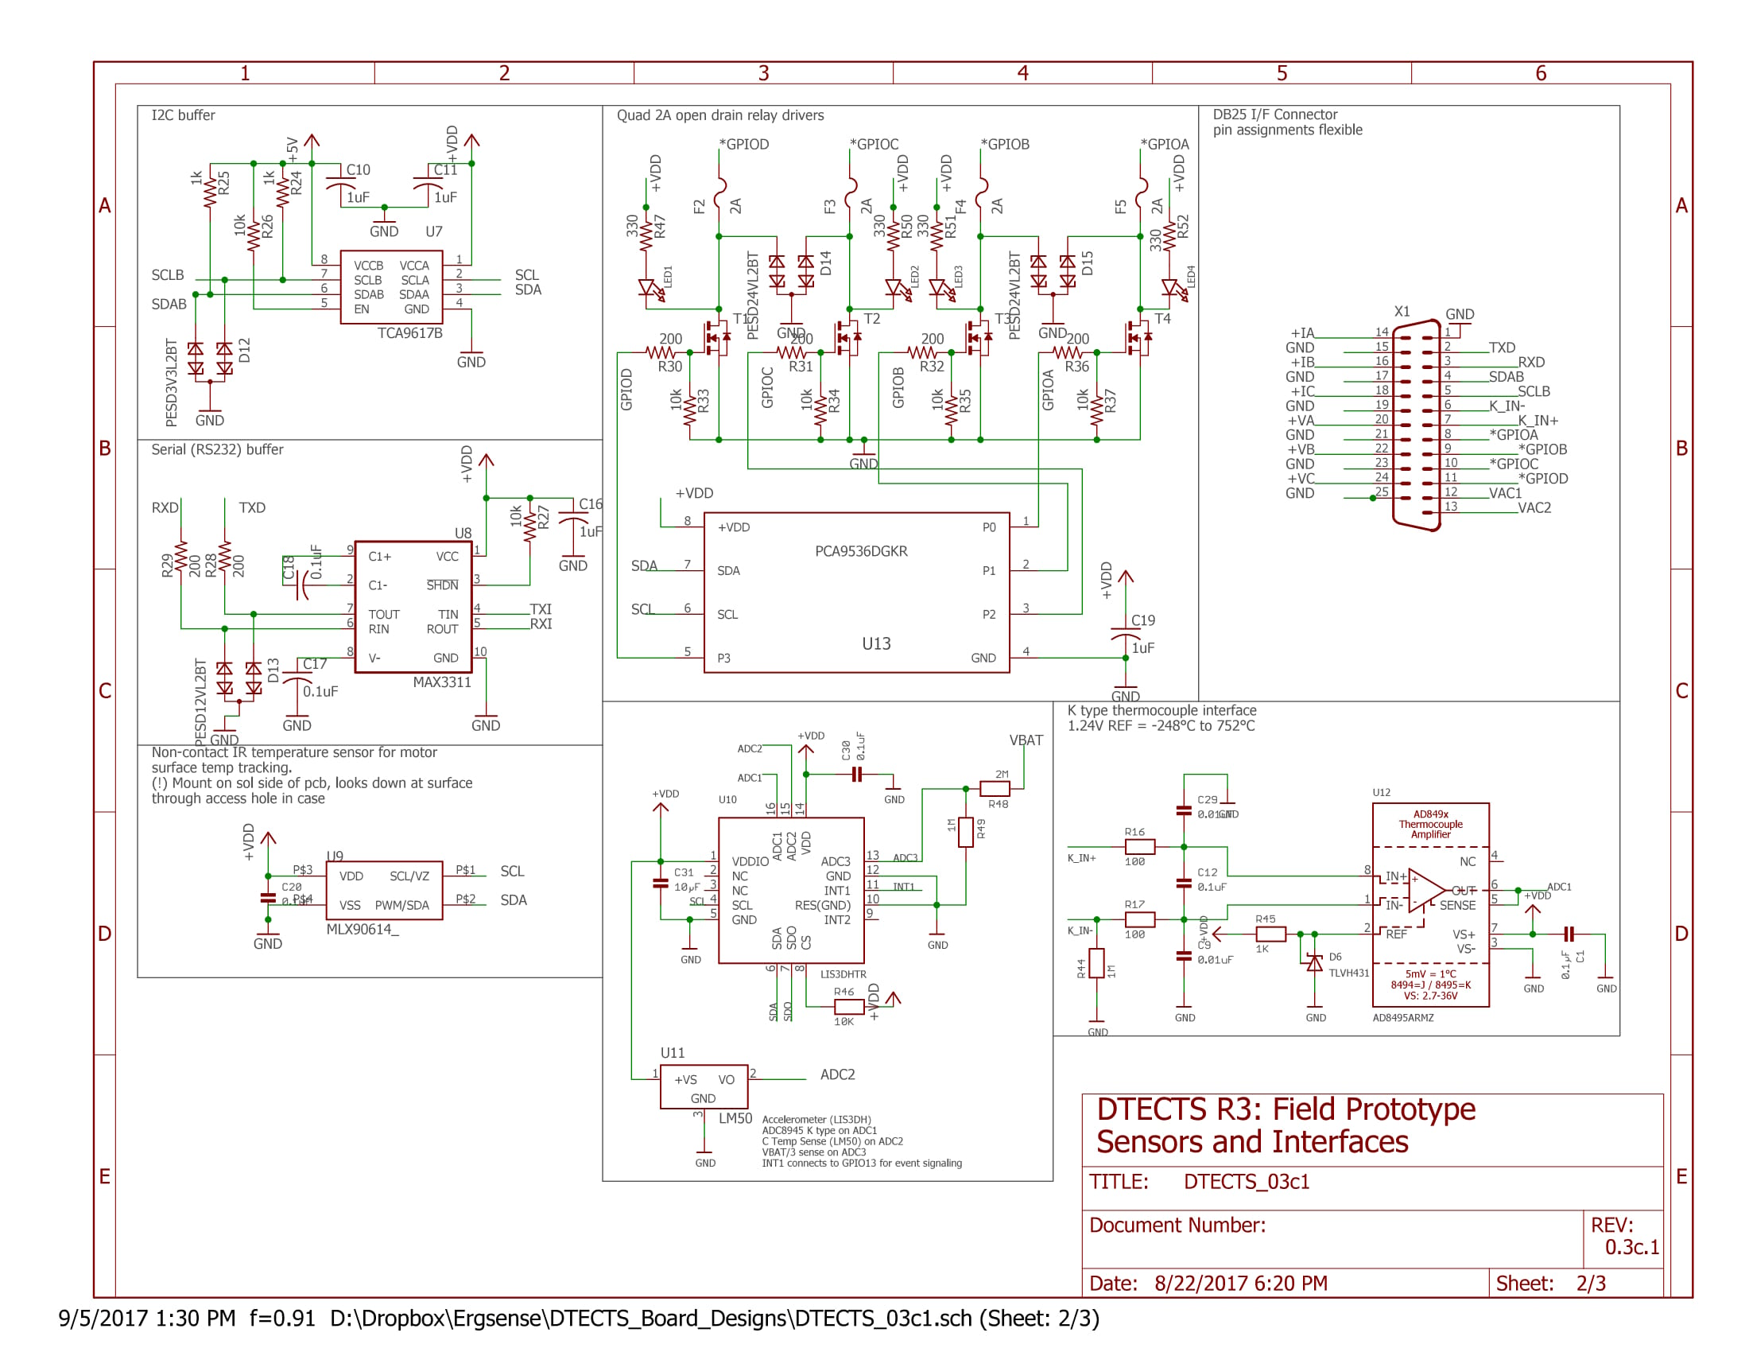
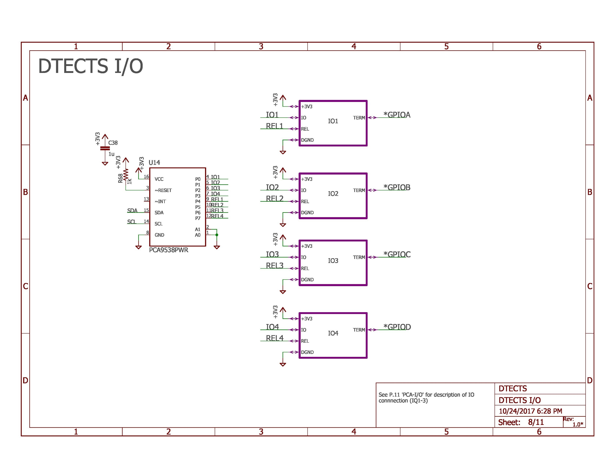
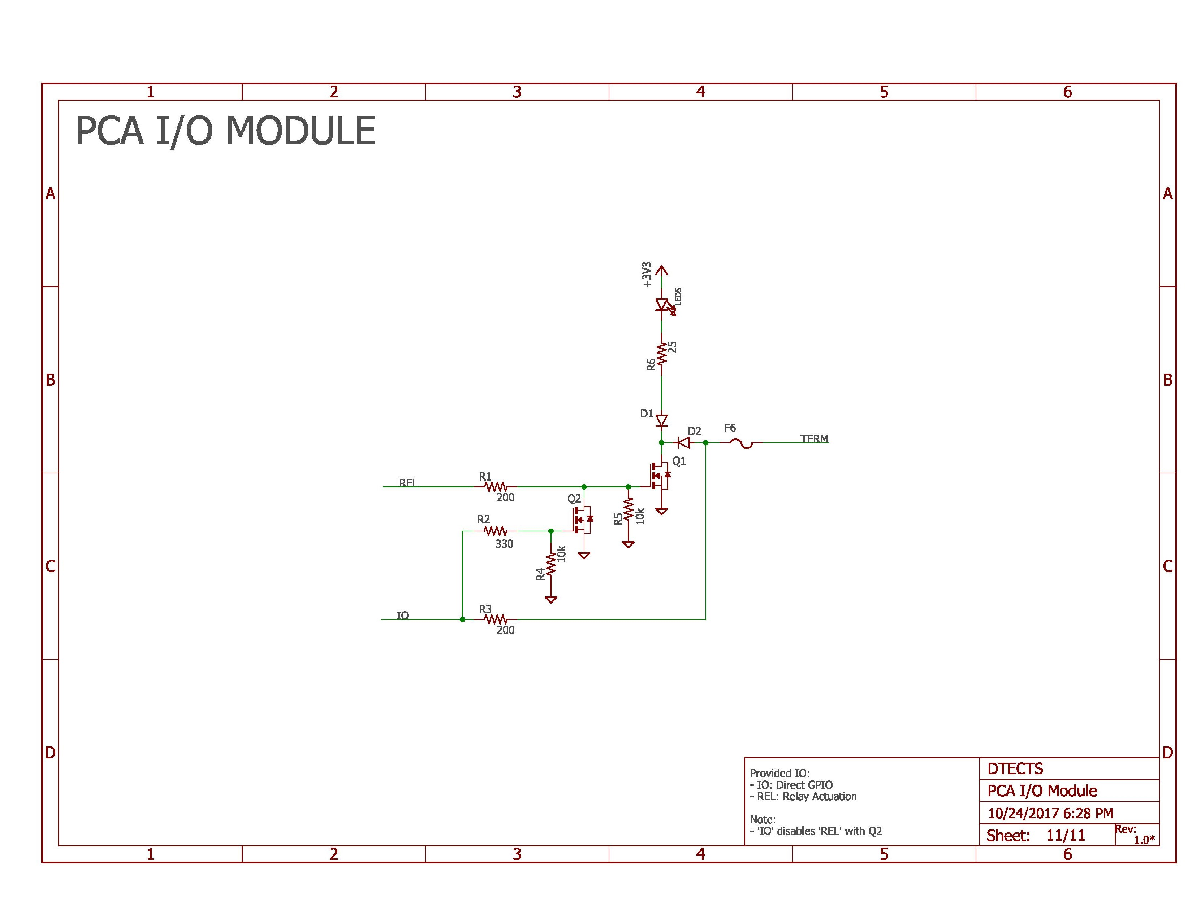
DTECTS Schematic Cleanup
Dense schematic
Rough Net Name Placement
Non-modularized
DTECTS 1.0C (2017)
DTECTS 0.3C (2016)
Notes:
Clear segmentation and modularization of design
Uniform, consistent layout
Clear labelling with notes

Slide 14
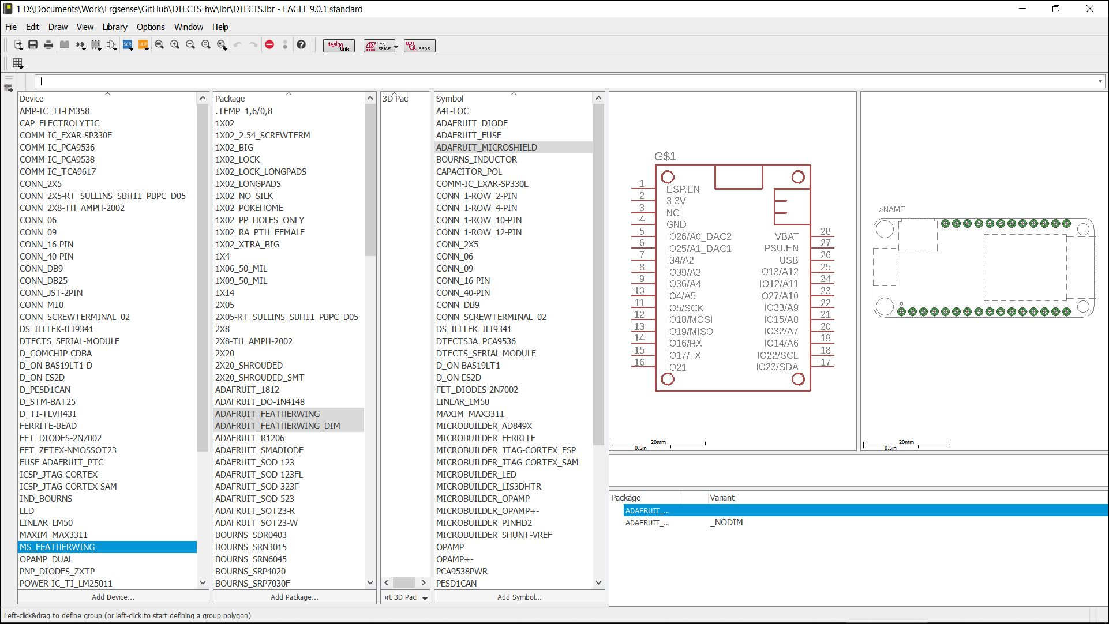
DTECTS Library
Notes:
Uniform naming schema
Consistent, uniform symbols
Complete silkscreen & outline markup

Slide 15
DTECTS Board Design
Notes:
Clear segmentation and modularization of design
Consistent part selection
Clean selection and placement for external I/O
Design flexibility for future expansion

Slide 16
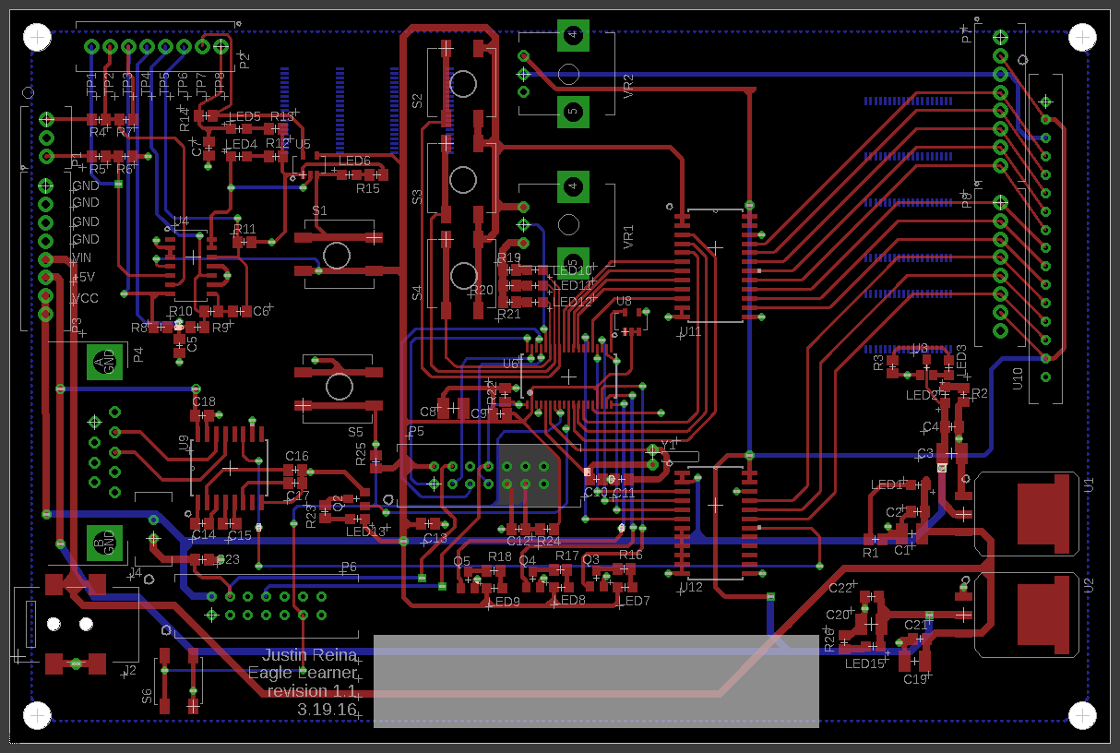
Board Layout (Reference)

Slide 17
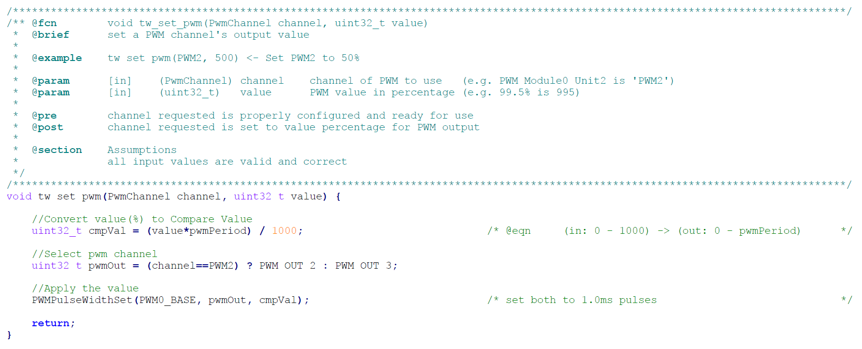
Firmware (Reference)

Slide 18
Overcome Challenges
Notes:
Unmet customer needs
Work scope identification
Espressif
Satisfying ambitious, abstract design needs

Slide 19
Deliverable & Results (2)
Notes:
Schematics
Documentation
Board Design
Espressif bare-metal scope
Roadmap establish
Procedure Reference
GitHub

Slide 20
Learnings & Growths
Notes:
Communication
Needs Identification & Customer Relations
Translation of Ambitions to Marketable Results
EAGLE Ramp
Espressif Exposure & Practice
Relationships

Slide 21
Outcomes
Notes:
Strengthened relations with Tomm
Tyler Brown Opportunity
Billy Keogh Opportunity
Jmr Opportunity
Mentor & Network relations
Xylem & Ergsense relations

Slide 22
Procedure
Notes:
Frame, sketch w/vision & intent, draft
Source control & procedure!
Help from experience (Tomm, Terry, Father)
Describe procedure of PPT Generation
selection & outline
customer meeting (Tomm)
mentor advise (Tom, Father)
outline
find template

Slide 23
Pivotal Value Statement
Notes:
Board Design
Board Fab & Validate
Firmware
Rapid Prototyping

Slide 24
_Notes_
[1] Feather - A complete line of development boards from Adafruit that are both standalone and stackable
Notes:
*Integrate Tomm Notes
*Form rules & presentation target

